Slide 1



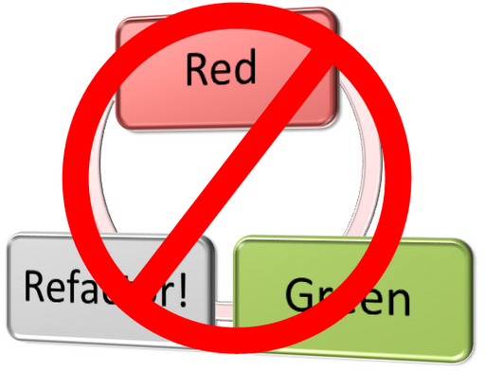
Test-Driven Development (TDD)
Learn the "Test First" Approach to Coding
Svetlin Nakov
Technical Trainer
www.nakov.com
Telerik Software Academy
academy.telerik.com

Slide 2

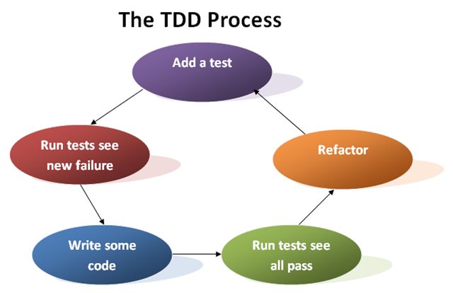
Code and Test vs. Test Driven Development

Slide 3
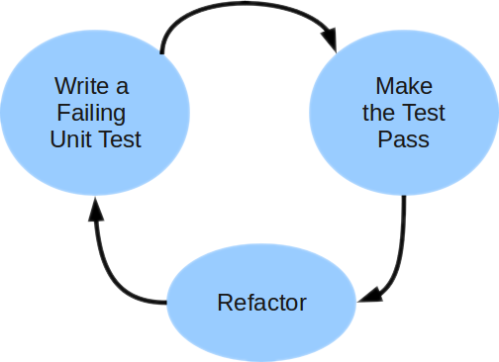
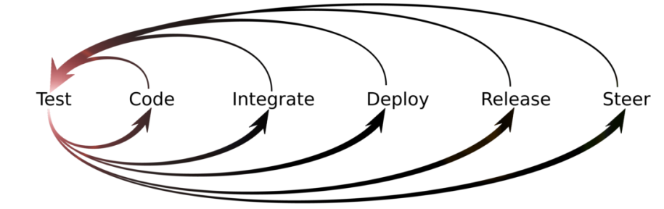
Unit Testing Approaches
"Code First" (code and test) approach
Classical approach
"Test First" approach
Test-driven development (TDD)

Slide 4
Code and Test Approach
Write code
Write unit test
Run and succeed
Time flow

Slide 5
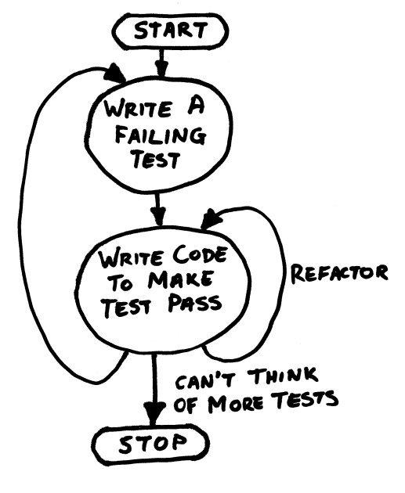
TDD in One Slide

Slide 6
Test-Driven Development (TDD)
Create a test list
Pick а test
Write test
Compile and fail
Write enough code to compile
Run test and fail
Write code to pass test
Time flow
Remove duplication

Slide 7


Why TDD?
TDD helps find design issues early
Avoids rework
Writing code to satisfy a test is a focused activity
Less chance of error
Tests will be more comprehensive than when written after code

Slide 8

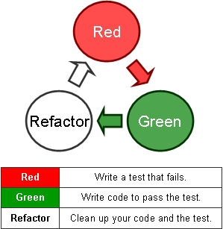
Test-Driven Development
Live Demo: Poker Hands Checker

Slide 9
Test-Driven Development (TDD)
http://academy.telerik.com

Slide 10
Homework
Finish the "Poker" project given in the Visual Studio Solution "11. Test-Driven-Development-Demo+Homework.zip" using TDD.
Write a class Card implementing the ICard interface. Implement the properties. Write a constructor. Implement the ToString() method. Test all cases.
Write a class Hand implementing the IHand interface. Implement the properties. Write a constructor. Implement the ToString() method. Test all cases.
Write a class PokerHandsChecker (+ tests) and start implementing the IPokerHandsChecker interface. Implement the IsValidHand(IHand). A hand is valid when it consists of exactly 5 different cards.

Slide 11
Homework (2)
Implement IPokerHandsChecker.IsFlush(IHand) method. Follow the official poker rules from Wikipedia: http://en.wikipedia.org/wiki/List_of_poker_hands
Implement IsFourOfAKind(IHand) method. Did you test all the scenarios?
* Implement the other check for poker hands: IsHighCard(IHand hand), IsOnePair(IHand hand), IsTwoPair(IHand hand), IsThreeOfAKind(IHand hand), IsFullHouse(IHand hand), IsStraight(IHand hand) and IsStraightFlush(IHand hand). Did you test all the scenarios well?
* Implement a card comparison logic for Poker hands (+ tests). CompareHands(…) should return -1, 0 or 1.

Slide 12




Free Trainings @ Telerik Academy
C# Programming @ Telerik Academy
csharpfundamentals.telerik.com
Telerik Software Academy
academy.telerik.com
Telerik Academy @ Facebook
facebook.com/TelerikAcademy
Telerik Software Academy Forums
forums.academy.telerik.com

